Slide 1
Introduction to Web API & Database
Tianmu Li, Julian de Gortari
UCLA Computer Science
litianmu1995@g.ucla.edu kiototeko@gmail.com 07/18/2021

Slide 2
Overview of Lecture
Part-1: Introduction to Web API
Web API: Simple Example
Web API vs Website
Exercise
Introduction to REST API
Working with REST API
Exercise
Part 1 Summary: Web API’s are part of larger ecosystem of web development. We will try to try to touch its basics and introduce the Web API’s.
Part-2: Project using Web API and MongoDB.

Slide 3


Web API : Simple Example
Application programming interface (API): Defines a method of communication between various software components.
Simple terms: Web API provides ways of using computing facilities over the internet (Query data, Store data, perform calculations, etc.).
Web API is an evolution of a web service.
Hi, this is Mr. Sandy. Can you tell me nearby hotels ?
Hello, Mr. Sandy. The nearby hotels are Waldorf Astoria Beverly Hills, Royal Palace Westwood Hotel, Holiday Inn Express West Los Angeles.
Example: Web API to search nearby hotels

Slide 4
Web API Example
Simple terms: Web API provides ways of using computing facilities over the internet (Query data, Store data, perform calculations, etc.).
Hi, this is Mr. XX. Can you tell me nearby hotels ?
Hello, Mr. XX. The nearby hotels are Waldorf Astoria Beverly Hills, Royal Palace Westwood Hotel, Holiday Inn Express West Los Angeles.
What are the different components of the web API in this example ?
Hint: How to Communicate/Contact to remote server? How to understand what we are sending and receiving? What is my query?
Few other things:
How to know we are serving the right person ?

Slide 5
Web API Example
Simple terms: Web API provides ways of using computing facilities over the internet (Query data, Store data, perform calculations, etc.).
Hi, this is Mr. XX. Can you tell me nearby hotels ?
Hello, Mr. XX. The nearby hotels are Waldorf Astoria Beverly Hills, Royal Palace Westwood Hotel, Holiday Inn Express West Los Angeles.
What are the different components of the web API in this example ?
Hint: How to Communicate/Contact to remote server? Communication protocols (HTTP) How to understand what we are sending and receiving? Formatted request & response (Generally: Json) What is my query? In request: Hotels close to me (close by how much, and what is my location?)
Few other things:
How to know we are serving the right person ? Authentication Verifying that the service requester is actually MR. XX.

Slide 6
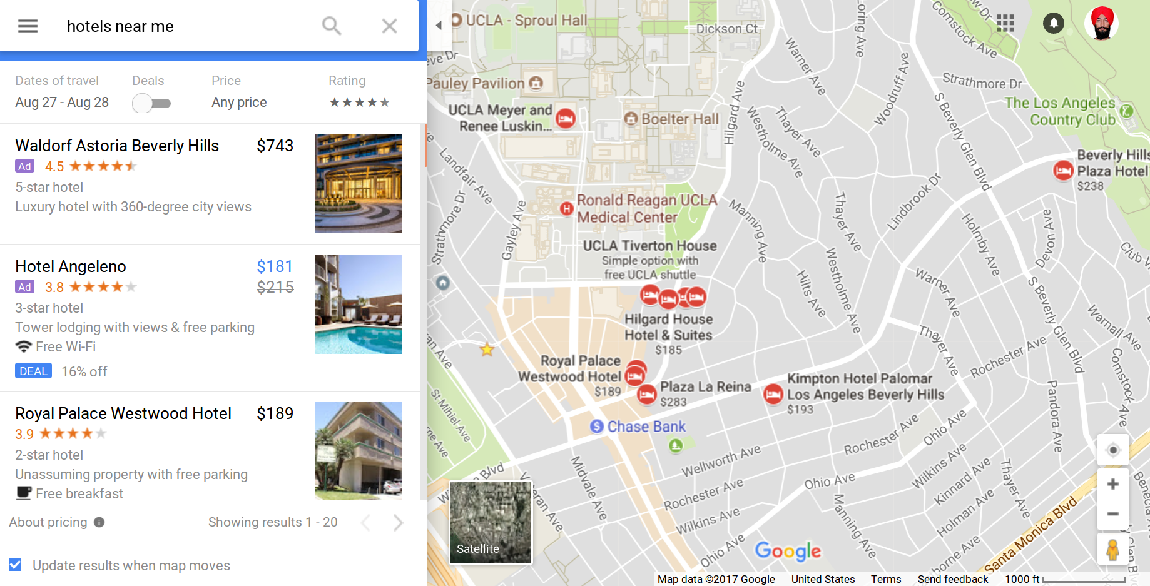
Web API vs Website
A Website is a collection of similar web pages. A Web page is a document displayed by a web browser.
A Website may or may not use a web API to query and get data from multiple servers. A Website takes care of data presentation for users, but a web API doesn’t do that.

Slide 7
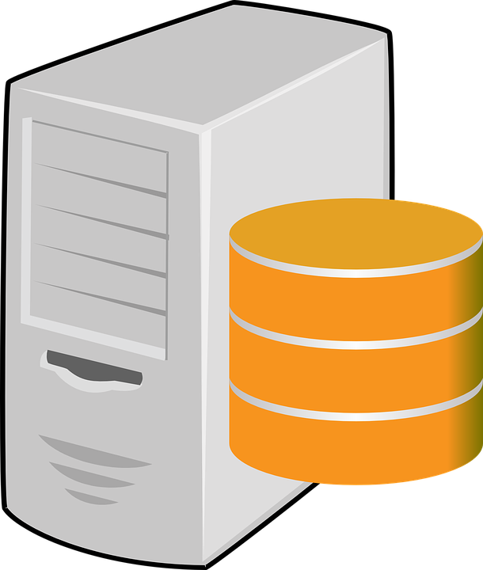
Web API vs Website
A Website takes care of data presentation for users, but a web API doesn’t do that.
WebPage: https://www.google.com/maps/search/hotels+near+me/@34.0635363,-118.4455592,15z
Query: Hotels near me, what is my location (Where to find hotels) & at what distance (In how much area to search).
https://maps.googleapis.com/maps/api/place/nearbysearch/json
Query: Hotels near 34.0635, -118.445 and Range R and API Key
Results: Hotels are UCLA Tiverton House, ...
Google Places Web API
Web Page displays data in web browser
Google Server

Slide 8
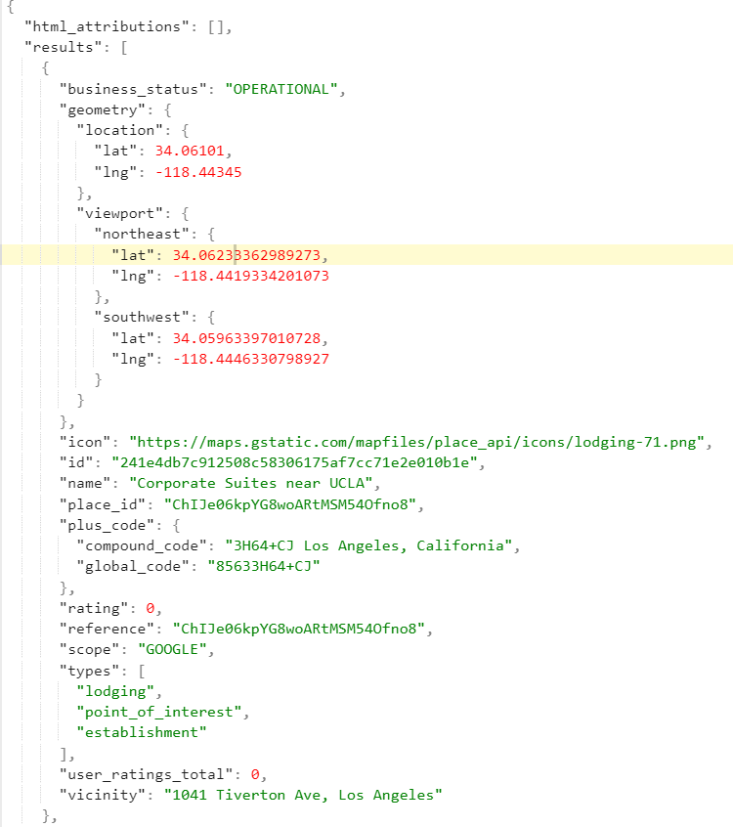
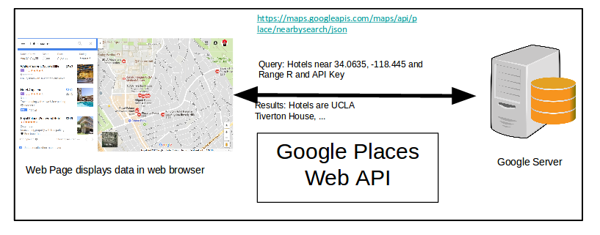
Web API vs Website
A Website takes care of data presentation for users, but a web API doesn’t do that.
WebPage: https://www.google.com/maps/search/hotels+near+me/@34.0635363,-118.4455592,15z
To See Web API Data:
https://maps.googleapis.com/maps/api/place/nearbysearch/json?location=34.0635363,-118.4455592&radius=1000&type=hotels&keyword=stay&key=%20AIzaSyD8wnikJHxQUBzztfsD8RvkV_wJAgi1-d8

Slide 9
Defining Web API
Simple terms: Web API provides ways of using computing facilities over the internet (Query data, Store data, perform calculations, etc.).
A Computer/Cluster/Cloud far away from user, may provide different functionalities to a user by offering a Web API. It is a concept not a technology.
This functionality may be:
Saving data.
Running computations (eg. query, transformations, calculations).
Returning results (data).
Or multiple of above.
Definition:
Web API is an application programming interface for a web server. Web API doesn’t include web server implementation details.
web API
Consumer
Web API Service Provider

Slide 10
Benefits of Web API
Loosely Coupled
Ease of Integration
Service Reuse
Web API 1
User Application 1 1 1
Web API 2
Web API 3
User Application 2 1 1
.
.
.
Web API n

Slide 11
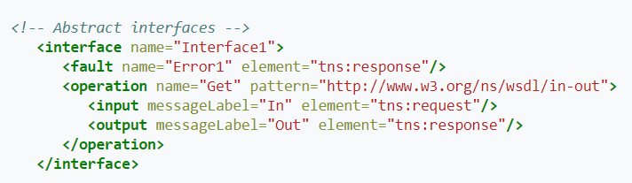
Web API History
Web API evolved from traditional web services. Web Services are complex and have some components with similar functionalities:
Web Services Description Language (WSDL): Describes how to call a web service, what are the input parameters and what data structure to return.
Simple Object Access Protocol (SOAP): Used to exchange information in web services. Web Service Registry: Web service providers publish services to it, and consumers use it to locate them.
Earlier information exchange, data and response was mostly in extensible markup language (XML) format. Today most of the web services functionality is provided using a web API which is implemented by a remote server.
Web API is easier to use, design and implement than Web Services

Slide 12
Components of Web API
In order to get functionality, we should know:
Required:
From where to get the service? Service URL of the API. Eg. https://maps.googleapis.com/maps/api/place/nearbysearch/json
What is the format of the request? Specifying query and input data etc. Eg. location=34.0635363,-118.4455592&radius=1000&type=hotels
What is the response format? Response can be a string, XML or Json Eg. Google places API returns result in Json format.
Optional:
How to differentiate between different users or restrict service access? Allowed users vs not allowed. Authentication. Eg: key
Error codes in the request? Inform user if anything is missing in the request. Error codes.

Slide 13
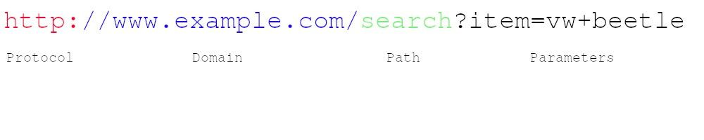
Uniform Resource Locator
A Uniform Resource Locator (URL) is a web address used to identify resources on the Web.
Hypertext Transfer Protocol (HTTP) specifies the rules followed by a requester in order to retrieve content from a server.

Slide 14
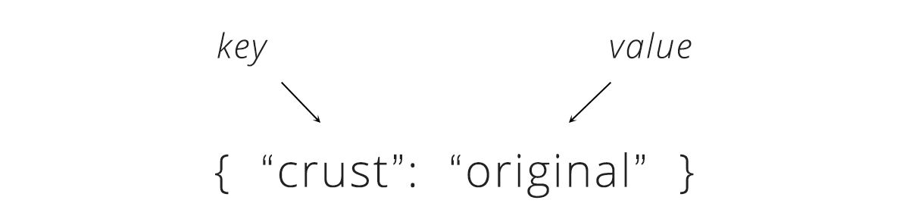
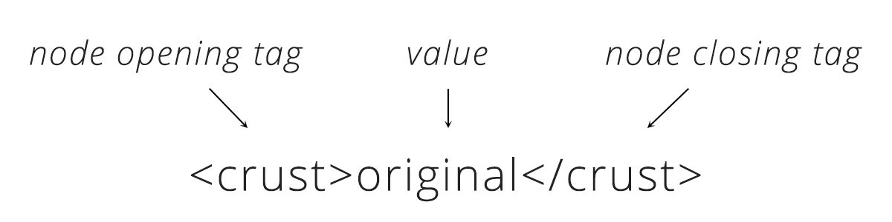
Response Format
Both JSON and XML can be used to receive data from a web server.
JSON is a very simple format that has two pieces: keys and values. Keys represent an attribute about the object being described
XML always starts with a root node, and inside it are more "child" nodes. The name of each node tells us the attribute of an object being described (like the key in JSON) and the data inside is the actual detail (like the value in JSON).

Slide 15
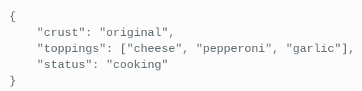
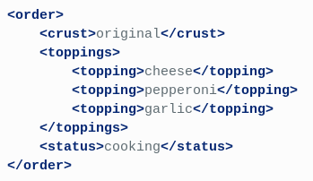
Response Format
XML is much more difficult to parse than JSON
JSON can be parsed into a ready-to-use JavaScript object.
For a pizza order:
JSON
XML

Slide 16
Exercise 1
Goal: Use the weather API of openweathermap.org to get the current weather details of a place.
Procedure: Put the query URL in a correct format in the browser and get some results.
Steps:
Query url: http://api.openweathermap.org/data/2.5/weather
Sample query: http://api.openweathermap.org/data/2.5/weather?lat=xxx&lon=xxx&units=Imperial&appid=xxx
Put latitude and longitude of a place of your choice.
Include appid (used for authentication) use: appid=a3276b42c9fbb481824cd2e6c23dd953

Slide 17
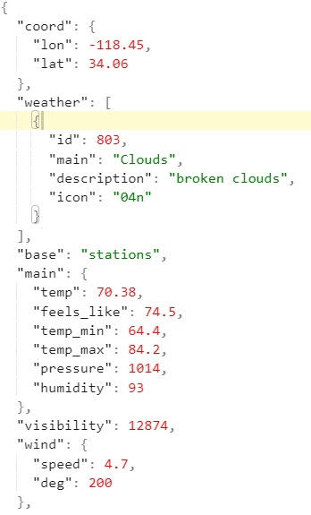
Sample output:
Query URL to use:
http://api.openweathermap.org/data/2.5/weather?lat=34.0635363&lon=-118.4455592&units=Imperial&appid=a3276b42c9fbb481824cd2e6c23dd953

Slide 18
Exercise 2: Using Web API in Python
API Query and receiving data:
Import the notebooks in Google Colab from the following url: https://github.com/UCLA-LACC-21/M3-Databases_WebAPI
Open exercise_2_web_21.ipynb
Put the output inside an online JSON editor: https://jsonformatter.org/
Try modifying the url to get different responses
Codes:
import requests
url=”http://api.openweathermap.org/data/2.5/weather?lat=34.0635363&lon=-118.4455592&units=Imperial&appid=a3276b42c9fbb481824cd2e6c23dd953”
response = requests.get(url)
print(response.text)
Output:
{"coord":{"lon":-118.45,"lat":34.06},"weather":[{"id":803,"main":"Clouds","description":"broken clouds","icon":"04n"}],"base":"stations","main":{"temp":70.38,"feels_like":74.5,"temp_min":64.4,"temp_max":84.2,"pressure":1014,"humidity":93},"visibility":12874,"wind":{"speed":4.7,"deg":200},"clouds":{"all":75},"dt":1594442381,"sys":{"type":1,"id":5872,"country":"US","sunrise":1594385442,"sunset":1594436844},"timezone":-25200,"id":5408522,"name":"Westwood, Los Angeles","cod":200}

Slide 19
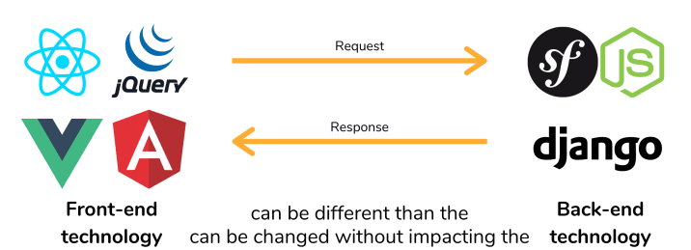
Back-end vs Front-end
When you use an API on your project, you will divide the visual part (front-end) from the server (back-end) that processes data.
It means that your application will be at least divided into two projects.

Slide 20
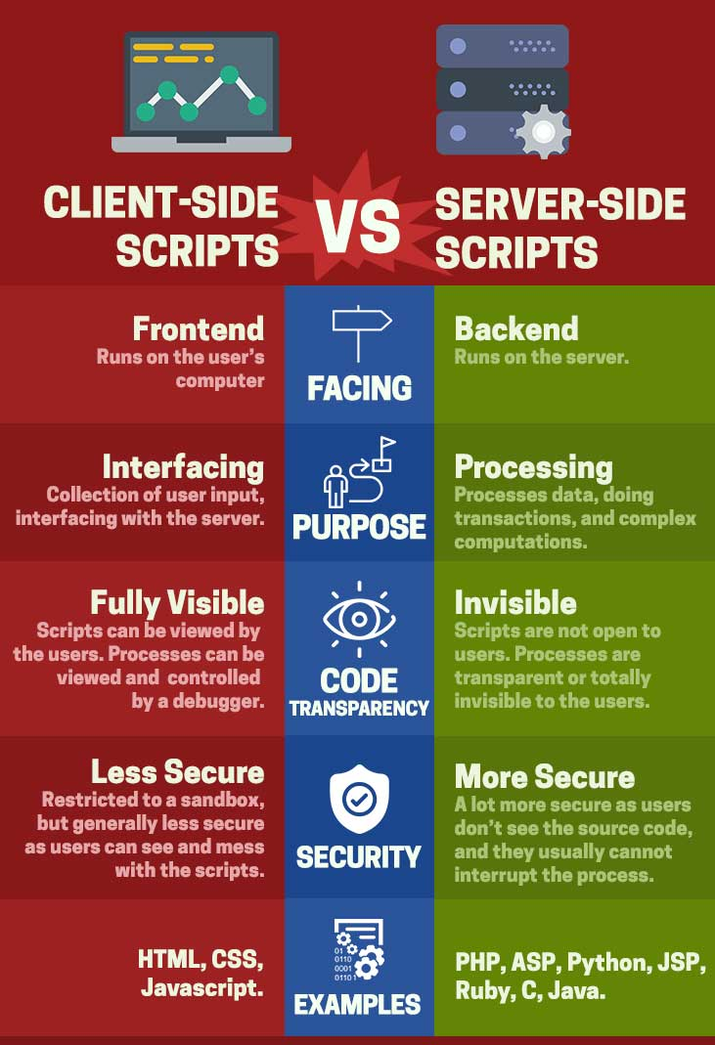
Client-side vs Server-side Scripts

Slide 21
Introduction to REST API
REpresentational State Transfer
An architectural style invented by Roy Fielding
Based on web-standards and the HTTP protocol
In a REST based architecture everything is a Resource
Resources are identified by global IDs (which are typically URIs or URLs)
Stateless in nature. Excellent for distributed systems

Slide 22
HTTP Methods
The PUT, GET, POST and DELETE methods are typically used in REST based architectures. The following table explains these operations:
HTTP Method | CRUD Operation | Description
POST | INSERT | Adds some input to an existing resource
PUT | UPDATE | Overrides an existing resource
GET | SELECT | Fetches a resource. The resource is never changed via a GET request
DELETE | DELETE | Deletes a resource

Slide 23
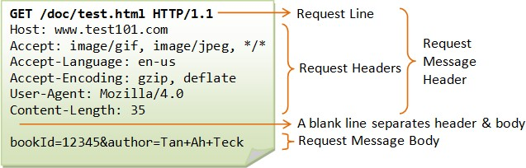
HTTP Request Example:

Slide 24
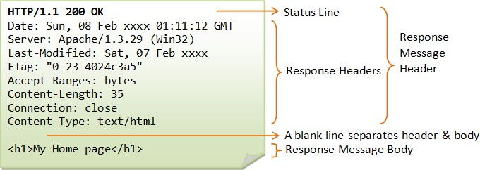
HTTP Response Example:

Slide 25
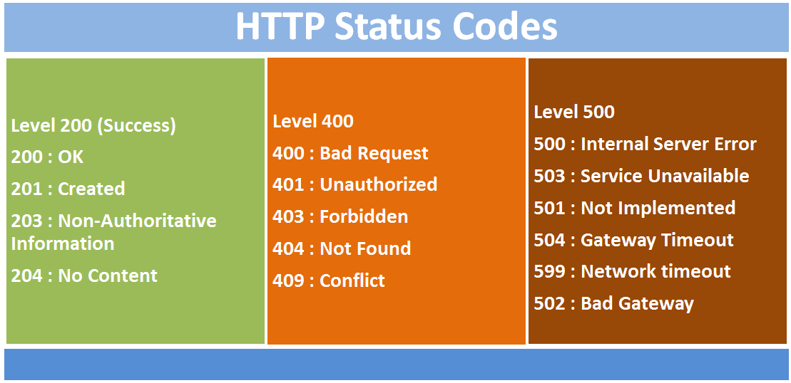

Slide 26
HTTP REST Request:
GET https://www.myhost.com/api/v1/user/1/cities
Read information from all the cities for a user whose id is 1
GET /user/1/cities http/1.1
host: https://www.myhost.com/api/v1 Content-Type: application/json Accept-Language: us-en
state_id: 2
HTTP REST API Request

Slide 27
HTTP REST Response:
HTTP/1.1 200 OK (285ms)
Date: Fri, 21 Apr 2017 10:27:20 GMT
Server: Apache/2.4.6 (CentOS) OpenSSL/1.0.1e-fips PHP/7.0.16 X-Powered-By: PHP/7.0.16
Content-Length: 109
Keep-Alive: timeout=5, max=100
Connection: Keep-Alive
Content-Type: application/json; charset=UTF-8
{"status":"success","message":"City
List","data":[{"city_name":"Visakhapatnam"},{"city_name":"Vijayawada"}]}
HTTP REST API Response

Slide 28
Exercise 3: Building a Web API Server
Execute the provided notebook (exercise_3.ipynb) and open the URL in the output of the last cell (look for http://{random_string}.ngrok.io).
On another webpage, append to the previous URL the string /weather?lat={latitude}&lon={longitude}. Observe the response.
Modify the code to query weather data given the provided latitude and longitude values. Optional
Enable different coordinate formats. Instead of lat={latitude}&lon={longitude}, also try to make it work with location={latitude}, {longitude}.
Enable input of city names. If the name of a place is provided instead of its coordinates, retrieve its coordinates using Google Places API (slide 8), and then use them to query its weather data. Example query for the coordinates of Los Angeles: https://maps.googleapis.com/maps/api/place/findplacefromtext/json?input=Los%20Angeles&inputtype=textquery&fields=photos,formatted_address,name,rating,opening_hours,geometry&key=%20AIzaSyD8wnikJHxQUBzztfsD8RvkV_wJAgi1-d8

Slide 29
NoSQL Databases: MongoDB
NoSQL: Used to Store data which is not in tabular form and is semi-structured.
Eg: Json data.
Also called not only SQL.
Today, used increasingly to store big data in web applications.
MongoDB: MongoDB is a document database with the scalability and flexibility that you want with the querying and indexing that you need.
Json data items are stored in documents. Documents are similar to tables. Every Json data item is equivalent to row.

Slide 30
Part-3: Project using Web API.
Goal: Given a location as input, find the hotels within a 10 Km range along with their weather conditions.
How many hotels did you get within 10 KM range.
Find the hotel with best rating.
Which hotel/hotels have the highest temperature.
Procedure:
1. Modify the Web API in the previous notebook to find nearby hotels given a place name.
2. Sort the hotels given their ratings.
3. Find the location of all the hotels.
3. Query weather information of all the hotels.

